Slide 1
Mininet
0616098 黃秉茂
0616031 李昀奇
0616004 陳緗菱

Slide 2
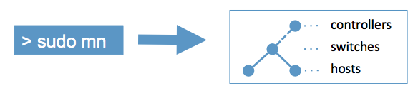
Mininet

Slide 3
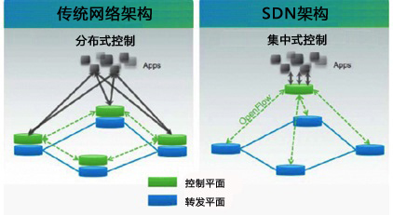
Control Plane
Per-router
Centralized

Slide 4
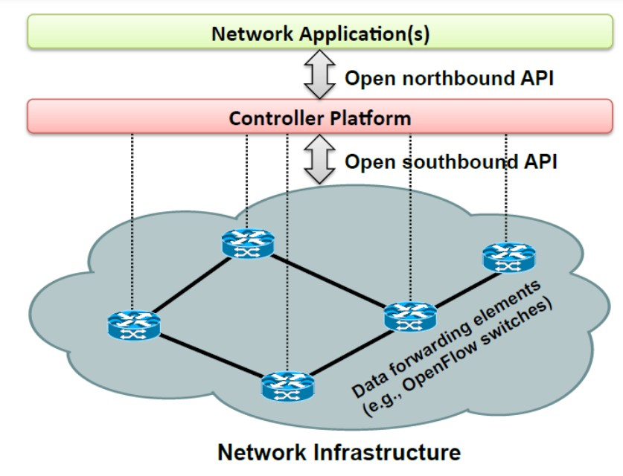
SDN(Software-defined networking)
定義
結構
南，北向接口
Control Layer
Infastructuer Layer
協定 : OPENFLOW
應用

Slide 5
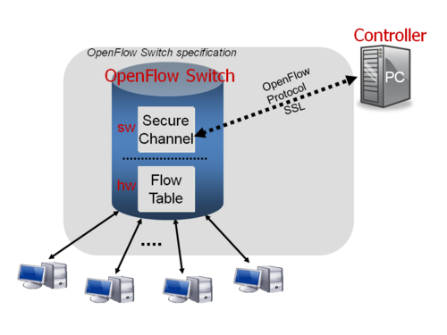
OPENFLOW
Structure
Remote controller
Openflow Switch
Flow Table
Secure Channel
Flow table
Flow entry
Header file
Action

Slide 6
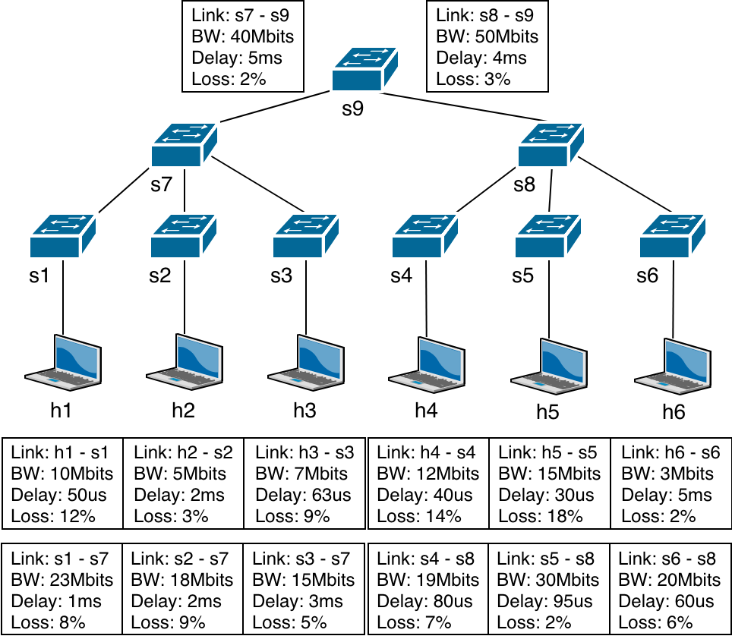
Lab

Slide 7
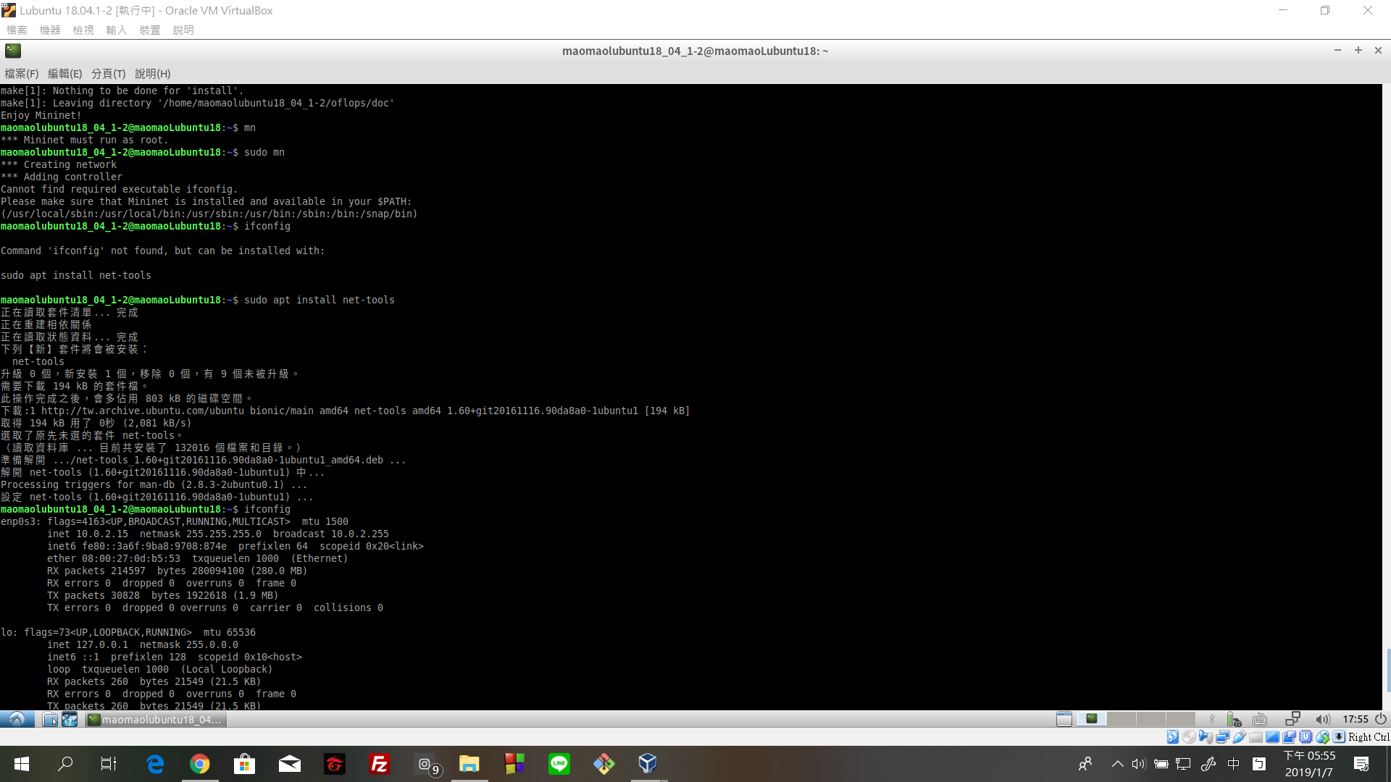
Mininet – Environment Setup
$ apt install git
$ sudo git clone git://github.com/mininet/mininet
$ sudo ./mininet/util/install.sh -a

Slide 8
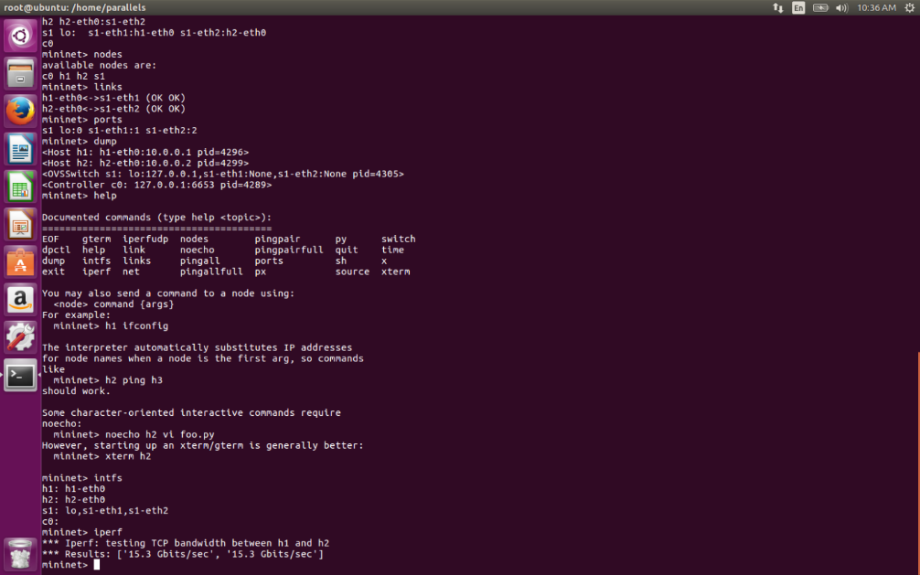
Command
Terminal
mn
mn –c
Mininet
iPerf
ping
exit
links

Slide 9
Python Code
$ git clone https://github.com/nctucn/lab2-maomao0819.git Route_Configuration

